Slide 1
DATA MINING
Introductory and Advanced Topics
Part III
Margaret H. Dunham
Department of Computer Science and Engineering
Southern Methodist University
Companion slides for the text by Dr. M.H.Dunham, Data Mining, Introductory and Advanced Topics, Prentice Hall, 2002.
© Prentice Hall

Slide 2
Data Mining Outline
PART I
  Introduction
  Related Concepts
  Data Mining Techniques
PART II
  Classification
  Clustering
  Association Rules
PART III
  Web Mining
  Spatial Mining
  Temporal Mining
© Prentice Hall

Slide 3
Web Mining Outline
Goal: Examine the use of data mining on the World Wide Web
Introduction
Web Content Mining
Web Structure Mining
Web Usage Mining
© Prentice Hall

Slide 4
Web Mining Issues
Size
  >350 million pages (1999)
  Grows at about 1 million pages a day
  Google indexes 3 billion documents
Diverse types of data
© Prentice Hall

Slide 5
Web Data
Web pages
Intra-page structures
Inter-page structures
Usage data
Supplemental data
  Profiles
  Registration information
  Cookies
© Prentice Hall

Slide 6
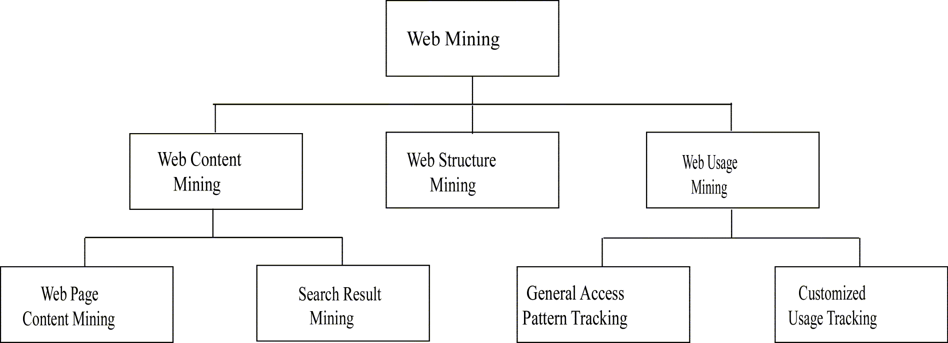
Web Mining Taxonomy
Modified from [zai01]
© Prentice Hall

Slide 7
Web Content Mining
Extends work of basic search engines
Search Engines
  IR application
  Keyword based
  Similarity between query and document
  Crawlers
  Indexing
  Profiles
  Link analysis
© Prentice Hall

Slide 8
Crawlers
Robot (spider) traverses the hypertext sructure in the Web.
Collect information from visited pages
Used to construct indexes for search engines
Traditional Crawler – visits entire Web (?) and replaces index
Periodic Crawler – visits portions of the Web and updates subset of index
Incremental Crawler – selectively searches the Web and incrementally modifies index
Focused Crawler – visits pages related to a particular subject
© Prentice Hall

Slide 9
Focused Crawler
Only visit links from a page if that page is determined to be relevant.
Classifier is static after learning phase.
Components:
  Classifier which assigns relevance score to each page based on crawl topic.
  Distiller to identify hub pages.
  Crawler visits pages to based on crawler and distiller scores.
© Prentice Hall

Slide 10
Focused Crawler
Classifier to related documents to topics
Classifier also determines how useful outgoing links are
Hub Pages contain links to many relevant pages. Must be visited even if not high relevance score.
© Prentice Hall

Slide 11
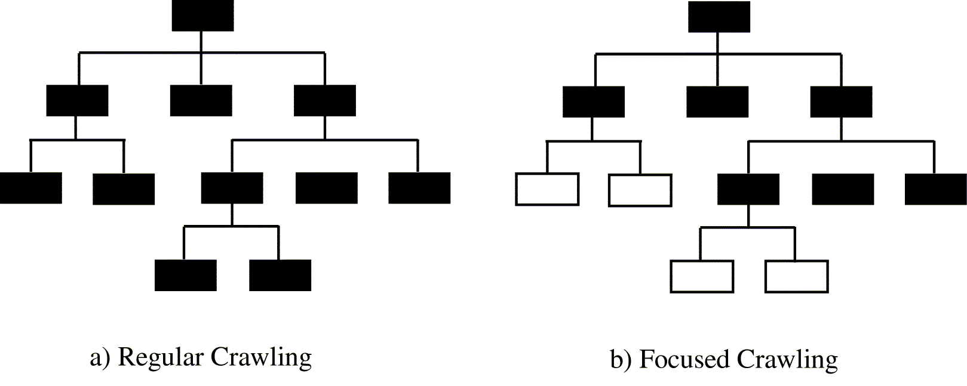
Focused Crawler
© Prentice Hall

Slide 12
Context Focused Crawler
Context Graph:
  Context graph created for each seed document .
  Root is the sedd document.
  Nodes at each level show documents with links to documents at next higher level.
  Updated during crawl itself .
Approach:
  Construct context graph and classifiers using seed documents as training data.
  Perform crawling using classifiers and context graph created.
© Prentice Hall

Slide 13
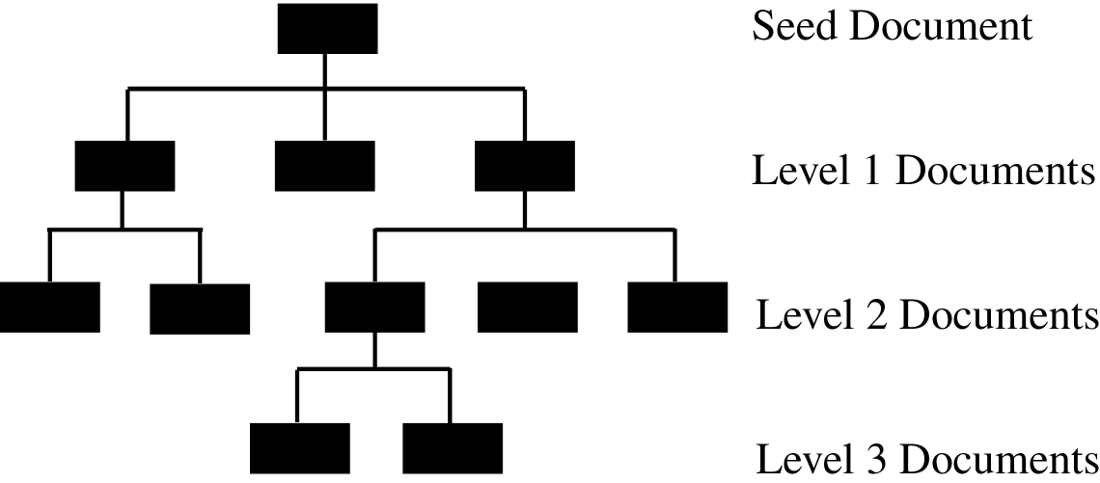
Context Graph
© Prentice Hall

Slide 14
Virtual Web View
Multiple Layered DataBase (MLDB) built on top of the Web.
Each layer of the database is more generalized (and smaller) and centralized than the one beneath it.
Upper layers of MLDB are structured and can be accessed with SQL type queries.
Translation tools convert Web documents to XML.
Extraction tools extract desired information to place in first layer of MLDB.
Higher levels contain more summarized data obtained through generalizations of the lower levels.
© Prentice Hall

Slide 15
Personalization
Web access or contents tuned to better fit the desires of each user.
Manual techniques identify user’s preferences based on profiles or demographics.
Collaborative filtering identifies preferences based on ratings from similar users.
Content based filtering retrieves pages based on similarity between pages and user profiles.
© Prentice Hall

Slide 16
Web Structure Mining
Mine structure (links, graph) of the Web
Techniques
  PageRank
  CLEVER
Create a model of the Web organization.
May be combined with content mining to more effectively retrieve important pages.
© Prentice Hall

Slide 17
PageRank
Used by Google
Prioritize pages returned from search by looking at Web structure.
Importance of page is calculated based on number of pages which point to it – Backlinks.
Weighting is used to provide more importance to backlinks coming form important pages.
© Prentice Hall

Slide 18
PageRank (cont’d)
PR(p) = c (PR(1)/N₁ + … + PR(n)/N_{n})
  PR(i): PageRank for a page i which points to target page p.
  N_{i}: number of links coming out of page i
© Prentice Hall

Slide 19
CLEVER
Identify authoritative and hub pages.
Authoritative Pages :
  Highly important pages.
  Best source for requested information.
Hub Pages :
  Contain links to highly important pages.
© Prentice Hall

Slide 20
HITS
Hyperlink-Induces Topic Search
Based on a set of keywords, find set of relevant pages – R.
Identify hub and authority pages for these.
  Expand R to a base set, B, of pages linked to or from R.
  Calculate weights for authorities and hubs.
Pages with highest ranks in R are returned.
© Prentice Hall

Slide 21
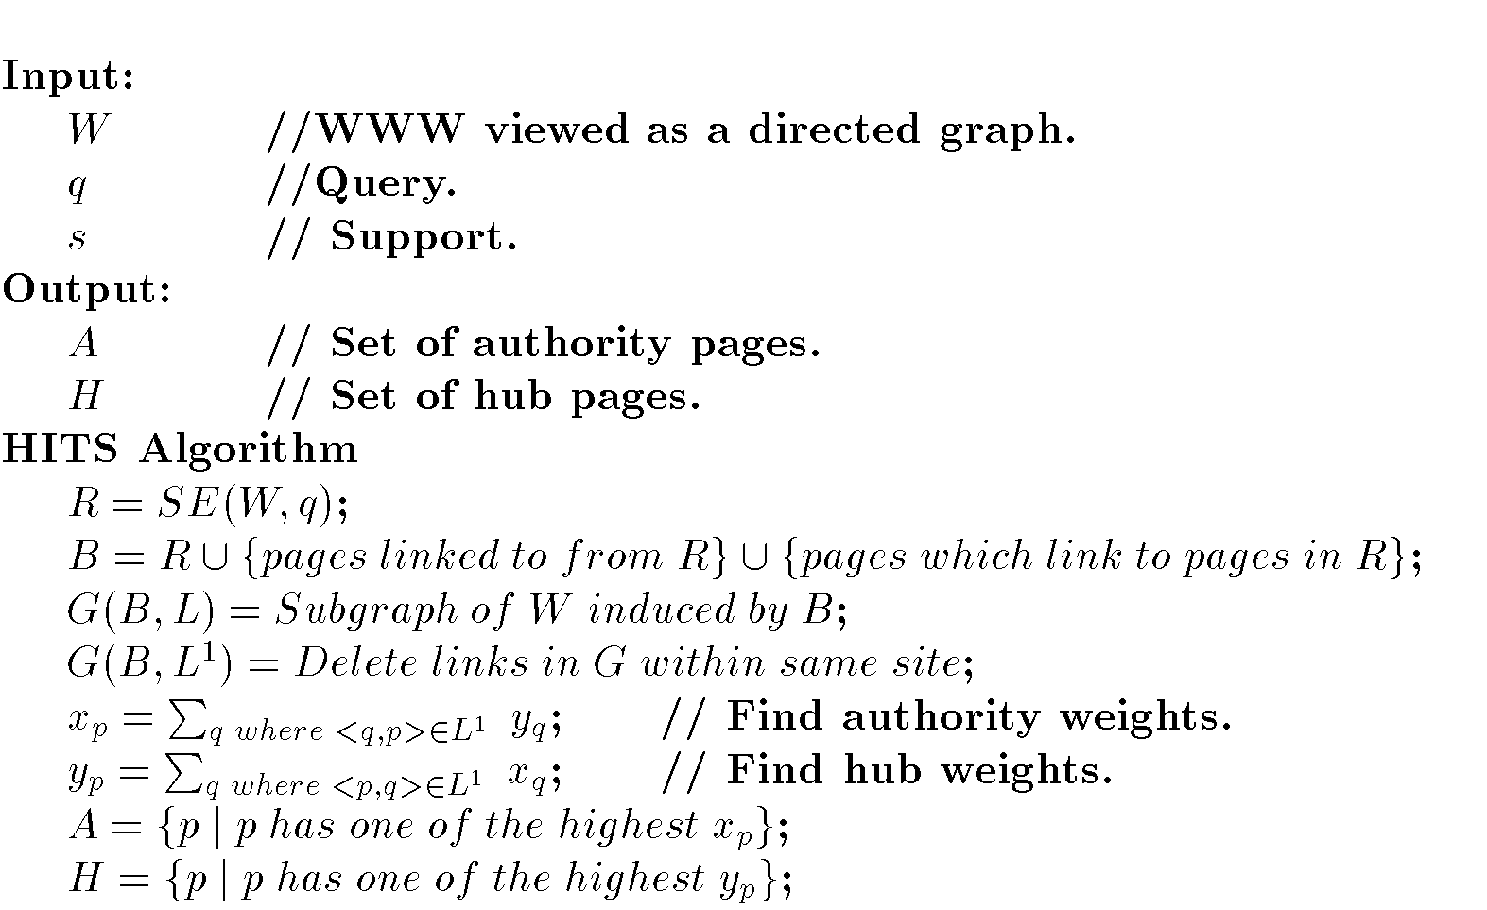
HITS Algorithm
© Prentice Hall

Slide 22
Web Usage Mining
Extends work of basic search engines
Search Engines
  IR application
  Keyword based
  Similarity between query and document
  Crawlers
  Indexing
  Profiles
  Link analysis
© Prentice Hall

Slide 23
Web Usage Mining Applications
Personalization
Improve structure of a site’s Web pages
Aid in caching and prediction of future page references
Improve design of individual pages
Improve effectiveness of e-commerce (sales and advertising)
© Prentice Hall

Slide 24
Web Usage Mining Activities
Preprocessing Web log
  Cleanse
  Remove extraneous information
  Sessionize
    Session: Sequence of pages referenced by one user at a sitting.
Pattern Discovery
  Count patterns that occur in sessions
  Pattern is sequence of pages references in session.
  Similar to association rules
    Transaction: session
    Itemset: pattern (or subset)
    Order is important
Pattern Analysis
© Prentice Hall

Slide 25
ARs in Web Mining
Web Mining:
  Content
  Structure
  Usage
Frequent patterns of sequential page references in Web searching.
Uses:
  Caching
  Clustering users
  Develop user profiles
  Identify important pages
© Prentice Hall

Slide 26
Web Usage Mining Issues
Identification of exact user not possible.
Exact sequence of pages referenced by a user not possible due to caching.
Session not well defined
Security, privacy, and legal issues
© Prentice Hall

Slide 27
Web Log Cleansing
Replace source IP address with unique but non-identifying ID.
Replace exact URL of pages referenced with unique but non-identifying ID.
Delete error records and records containing not page data (such as figures and code)
© Prentice Hall

Slide 28
Sessionizing
Divide Web log into sessions.
Two common techniques:
  Number of consecutive page references from a source IP address occurring within a predefined time interval (e.g. 25 minutes).
  All consecutive page references from a source IP address where the interclick time is less than a predefined threshold.
© Prentice Hall

Slide 29
Data Structures
Keep track of patterns identified during Web usage mining process
Common techniques:
  Trie
  Suffix Tree
  Generalized Suffix Tree
  WAP Tree
© Prentice Hall

Slide 30
Trie vs. Suffix Tree
Trie:
  Rooted tree
  Edges labeled which character (page) from pattern
  Path from root to leaf represents pattern.
Suffix Tree:
  Single child collapsed with parent. Edge contains labels of both prior edges.
© Prentice Hall

Slide 31
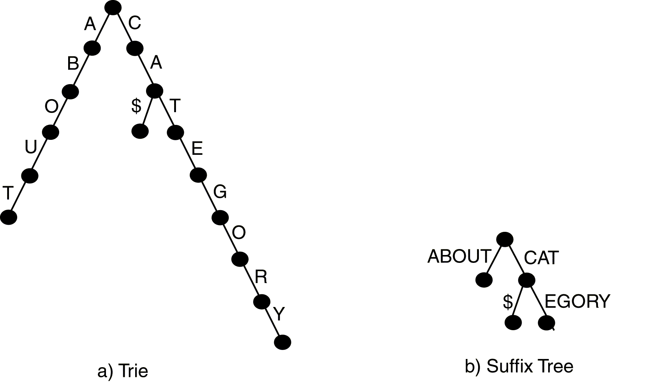
Trie and Suffix Tree
© Prentice Hall

Slide 32
Generalized Suffix Tree
Suffix tree for multiple sessions.
Contains patterns from all sessions.
Maintains count of frequency of occurrence of a pattern in the node.
WAP Tree:
  Compressed version of generalized suffix tree
© Prentice Hall

Slide 33
Types of Patterns
Algorithms have been developed to discover different types of patterns.
Properties:
  Ordered – Characters (pages) must occur in the exact order in the original session.
  Duplicates – Duplicate characters are allowed in the pattern.
  Consecutive – All characters in pattern must occur consecutive in given session.
  Maximal – Not subsequence of another pattern.
© Prentice Hall

Slide 34
Pattern Types
Association Rules
  None of the properties hold
Episodes
  Only ordering holds
Sequential Patterns
  Ordered and maximal
Forward Sequences
  Ordered, consecutive, and maximal
Maximal Frequent Sequences
  All properties hold
© Prentice Hall

Slide 35
Episodes
Partially ordered set of pages
Serial episode – totally ordered with time constraint
Parallel episode – partial ordered with time constraint
General episode – partial ordered with no time constraint
© Prentice Hall

Slide 36
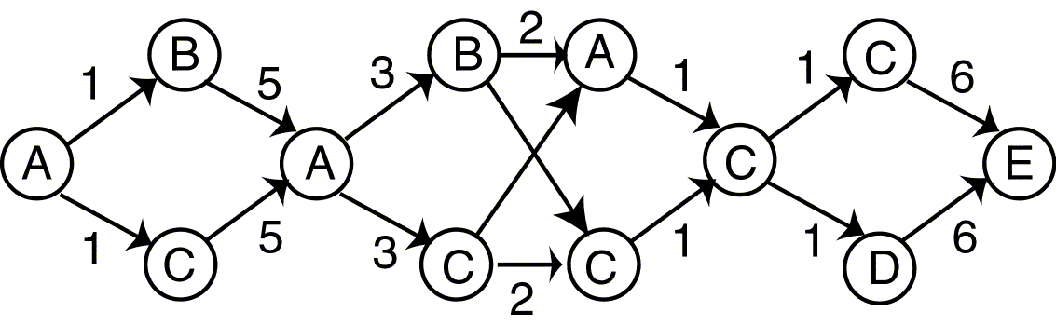
DAG for Episode
© Prentice Hall

Slide 37
Spatial Mining Outline
Goal: Provide an introduction to some spatial mining techniques.
Introduction
Spatial Data Overview
Spatial Data Mining Primitives
Generalization/Specialization
Spatial Rules
Spatial Classification
Spatial Clustering
© Prentice Hall

Slide 38
Spatial Object
Contains both spatial and nonspatial attributes.
Must have a location type attributes:
  Latitude/longitude
  Zip code
  Street address
May retrieve object using either (or both) spatial or nonspatial attributes.
© Prentice Hall

Slide 39
Spatial Data Mining Applications
Geology
GIS Systems
Environmental Science
Agriculture
Medicine
Robotics
May involved both spatial and temporal aspects
© Prentice Hall

Slide 40
Spatial Queries
Spatial selection may involve specialized selection comparison operations:
  Near
  North, South, East, West
  Contained in
  Overlap/intersect
Region (Range) Query – find objects that intersect a given region.
Nearest Neighbor Query – find object close to identified object.
Distance Scan – find object within a certain distance of an identified object where distance is made increasingly larger.
© Prentice Hall

Slide 41
Spatial Data Structures
Data structures designed specifically to store or index spatial data.
Often based on B-tree or Binary Search Tree
Cluster data on disk basked on geographic location.
May represent complex spatial structure by placing the spatial object in a containing structure of a specific geographic shape.
Techniques:
  Quad Tree
  R-Tree
  k-D Tree
© Prentice Hall

Slide 42
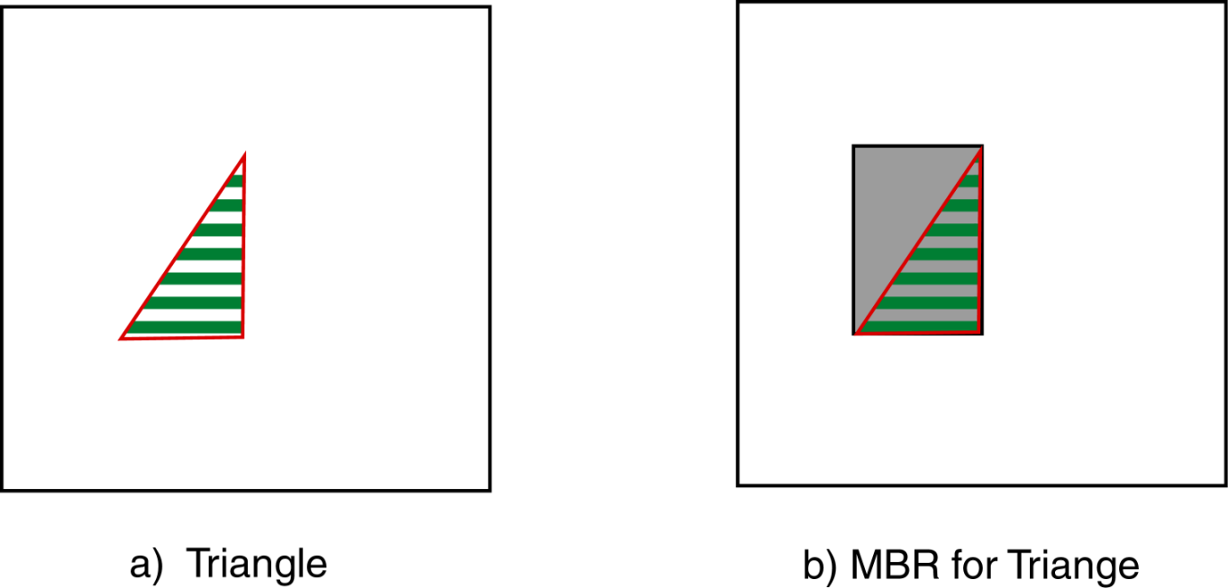
MBR
Minimum Bounding Rectangle
Smallest rectangle that completely contains the object
© Prentice Hall

Slide 43
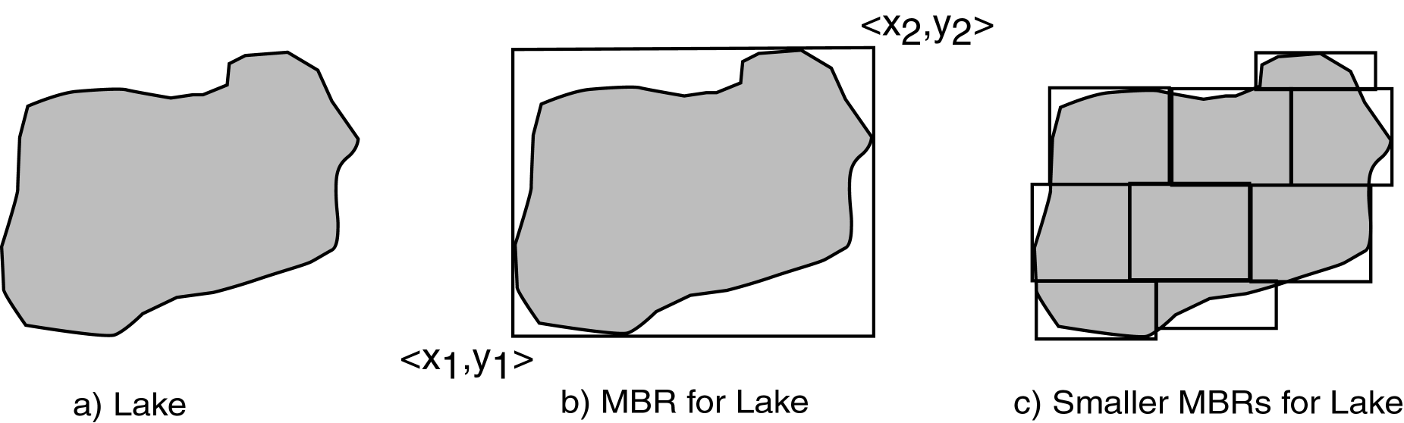
MBR Examples
© Prentice Hall

Slide 44
Quad Tree
Hierarchical decomposition of the space into quadrants (MBRs)
Each level in the tree represents the object as the set of quadrants which contain any portion of the object.
Each level is a more exact representation of the object.
The number of levels is determined by the degree of accuracy desired.
© Prentice Hall

Slide 45
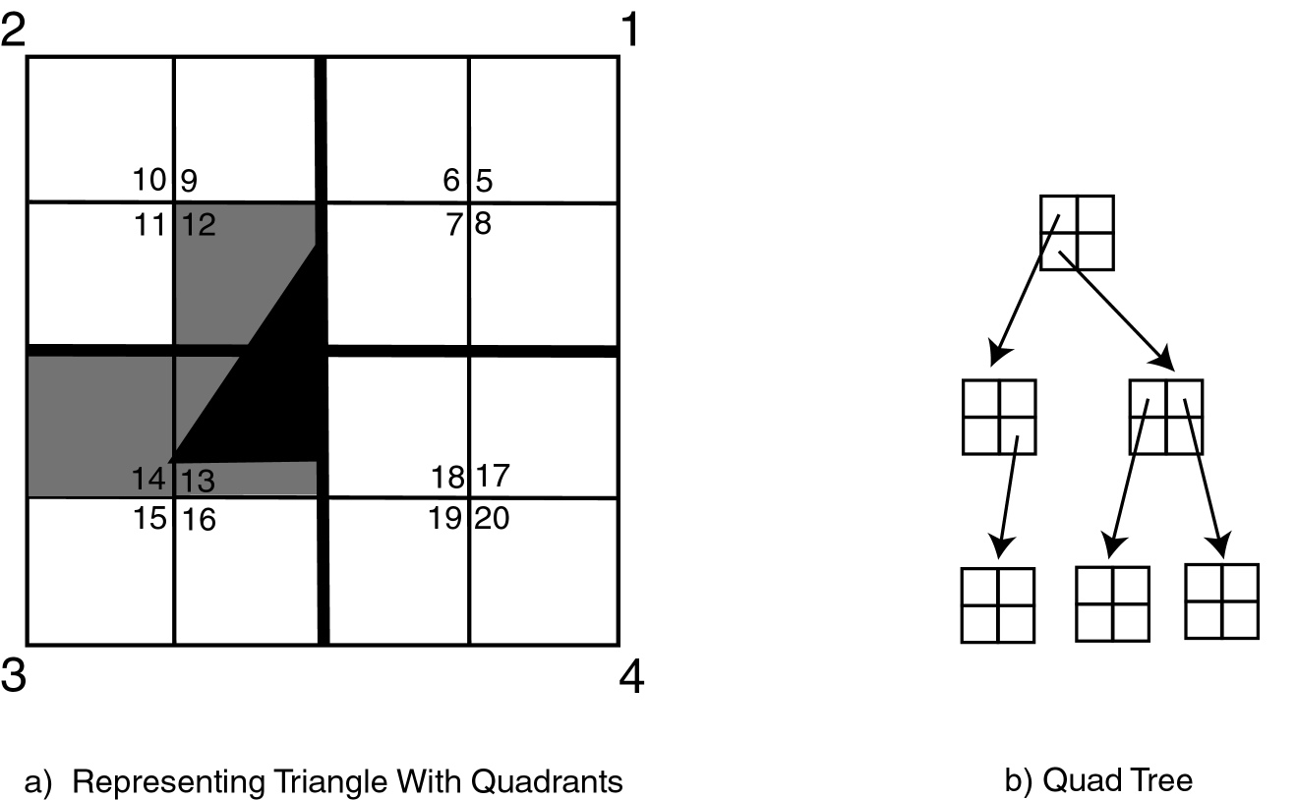
Quad Tree Example
© Prentice Hall

Slide 46
R-Tree
As with Quad Tree the region is divided into successively smaller rectangles (MBRs).
Rectangles need not be of the same size or number at each level.
Rectangles may actually overlap.
Lowest level cell has only one object.
Tree maintenance algorithms similar to those for B-trees.
© Prentice Hall

Slide 47
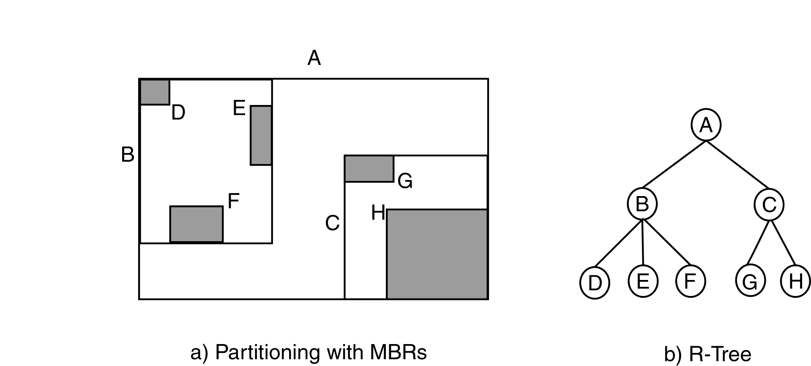
R-Tree Example
© Prentice Hall

Slide 48
K-D Tree
Designed for multi-attribute data, not necessarily spatial
Variation of binary search tree
Each level is used to index one of the dimensions of the spatial object.
Lowest level cell has only one object
Divisions not based on MBRs but successive divisions of the dimension range.
© Prentice Hall

Slide 49
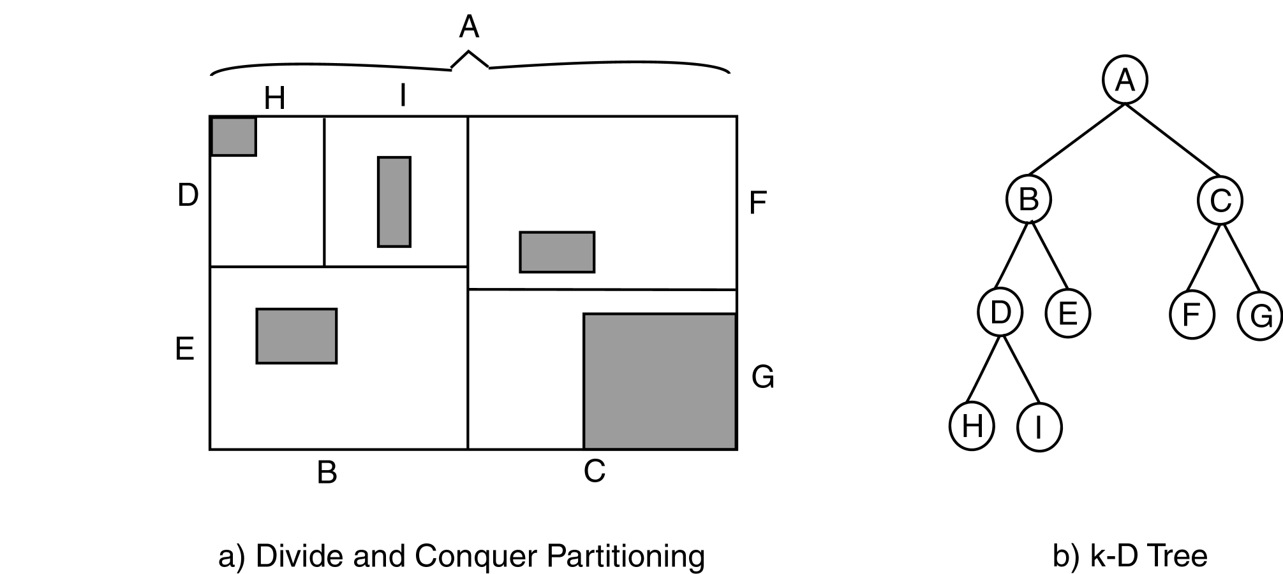
k-D Tree Example
© Prentice Hall

Slide 50
Topological Relationships
Disjoint
Overlaps or Intersects
Equals
Covered by or inside or contained in
Covers or contains
© Prentice Hall

Slide 51
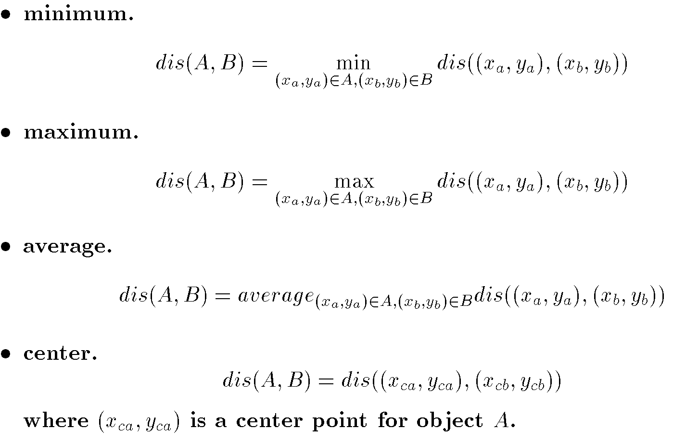
Distance Between Objects
Euclidean
Manhattan
Extensions:
© Prentice Hall

Slide 52
Progressive Refinement
Make approximate answers prior to more accurate ones.
Filter out data not part of answer
Hierarchical view of data based on spatial relationships
Coarse predicate recursively refined
© Prentice Hall

Slide 53
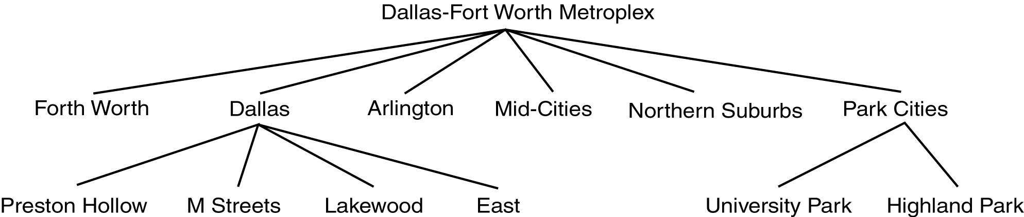
Progressive Refinement
© Prentice Hall

Slide 54
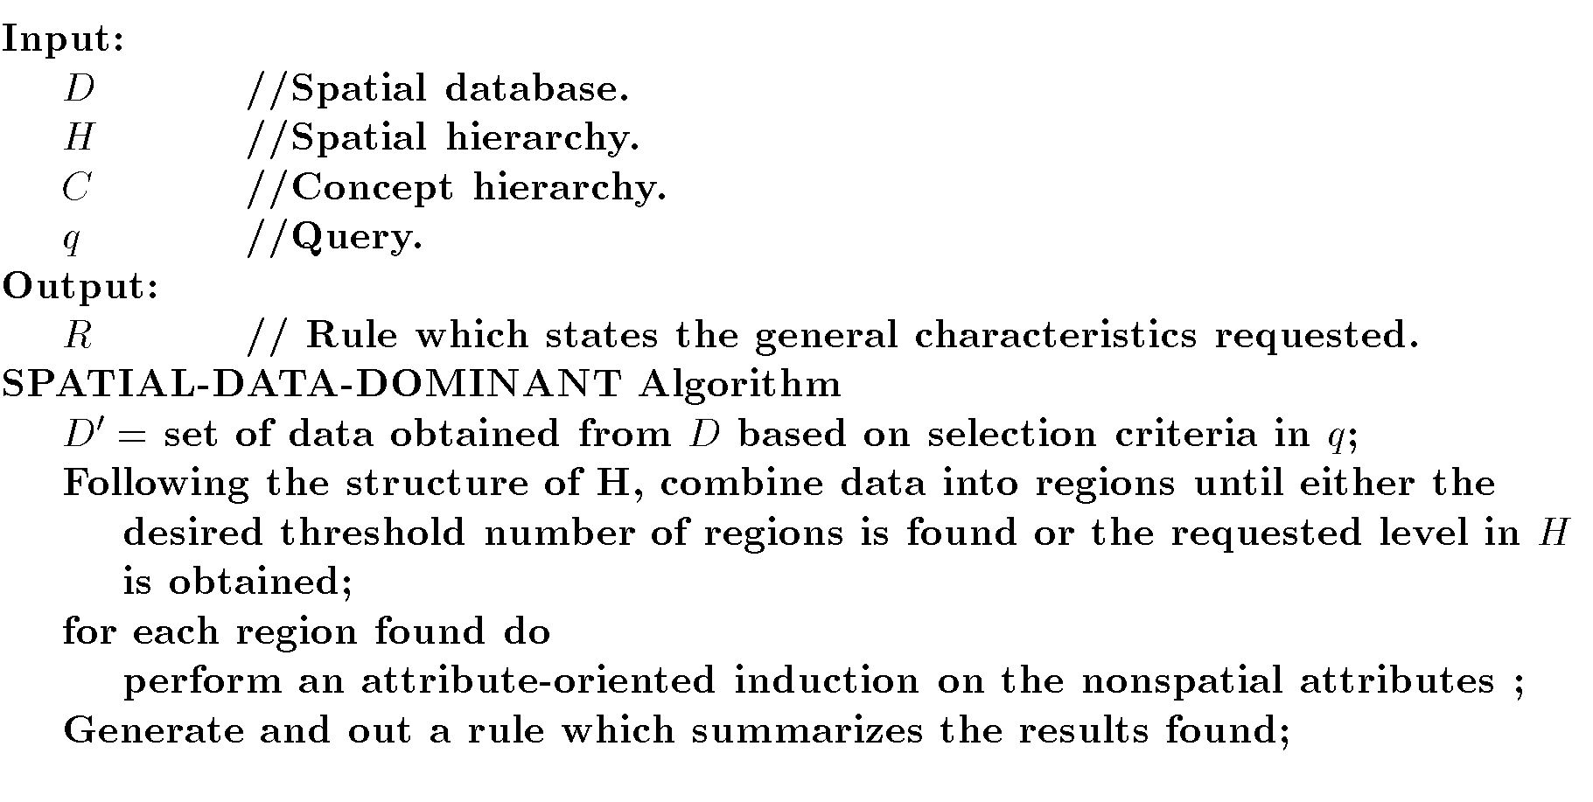
Spatial Data Dominant Algorithm
© Prentice Hall

Slide 55
STING
STatistical Information Grid-based
Hierarchical technique to divide area into rectangular cells
Grid data structure contains summary information about each cell
Hierarchical clustering
Similar to quad tree
© Prentice Hall

Slide 56
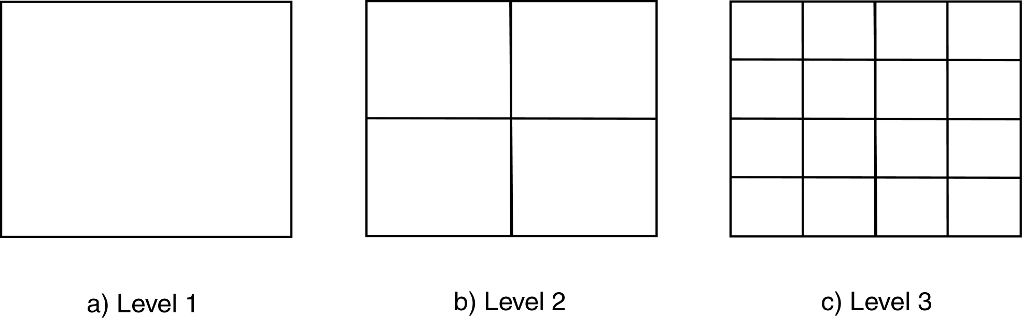
STING
© Prentice Hall

Slide 57
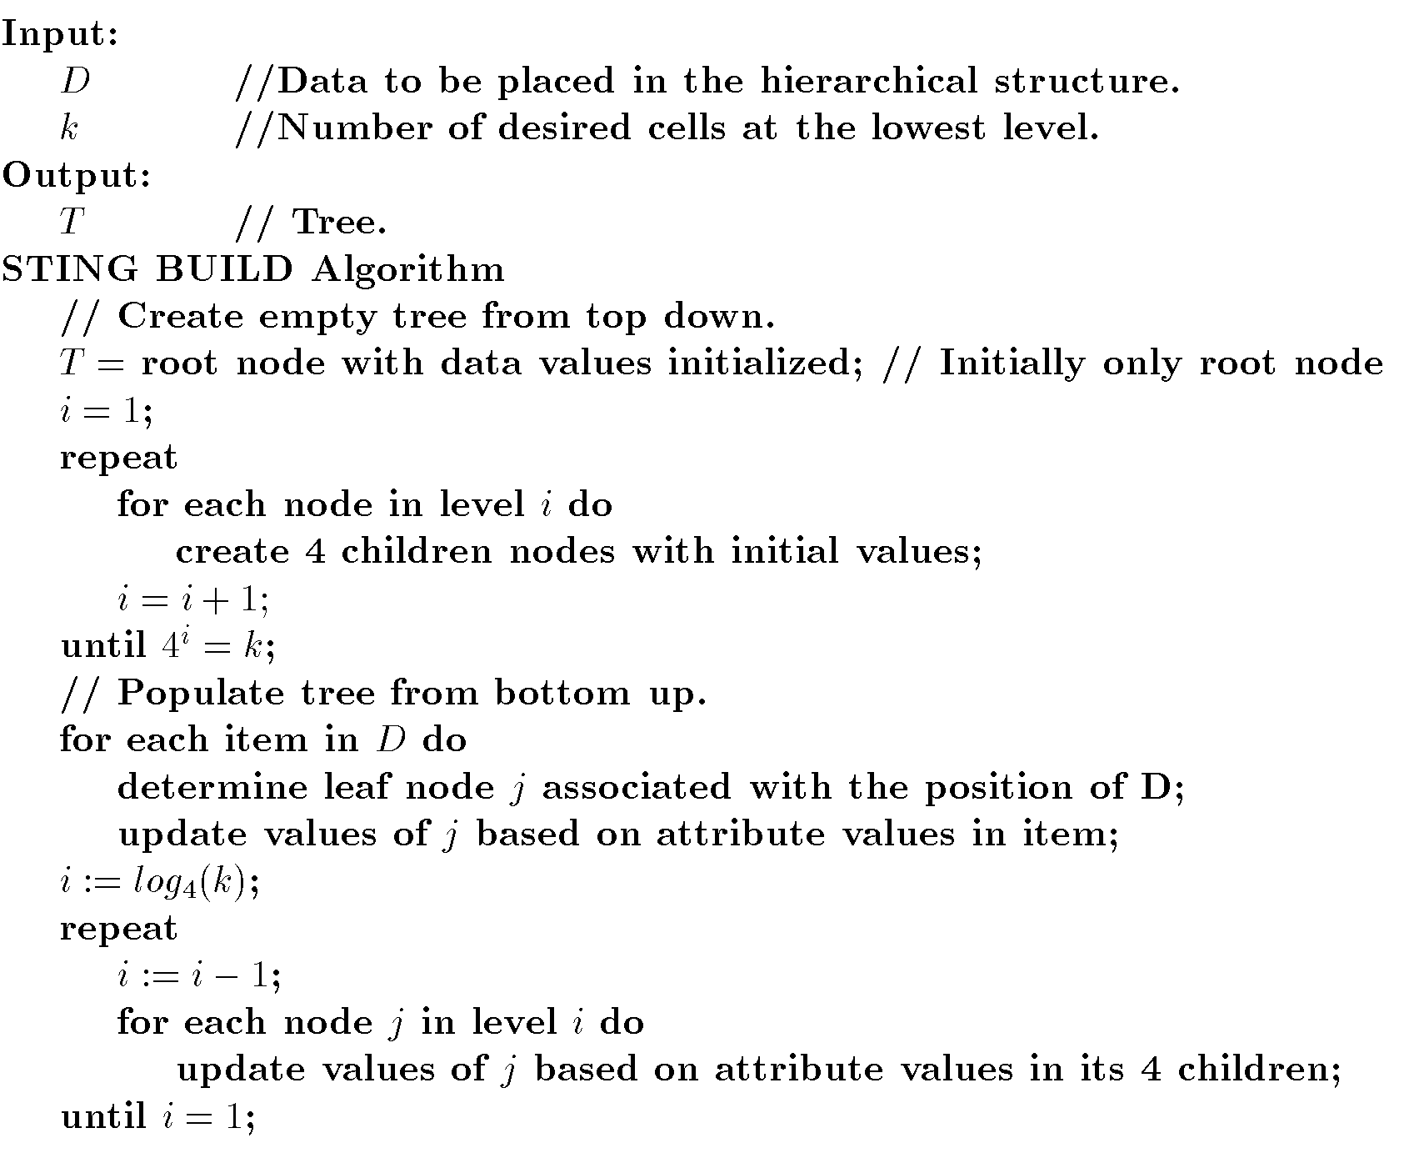
STING Build Algorithm
© Prentice Hall

Slide 58
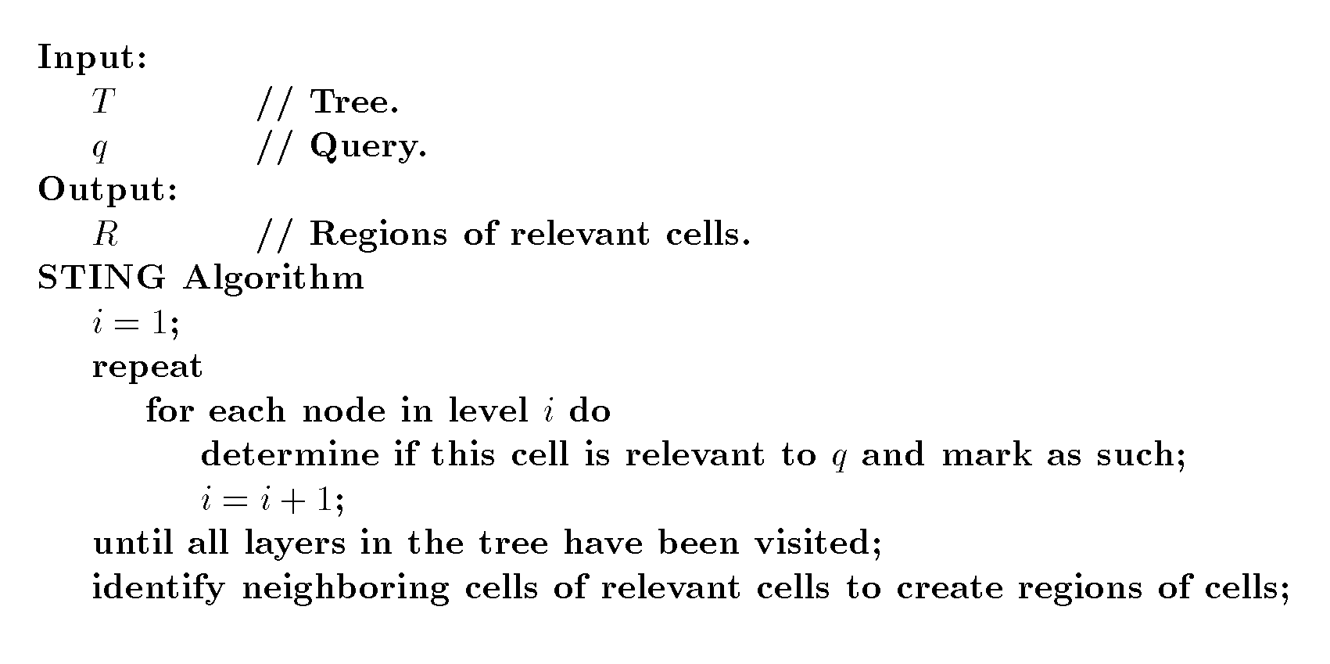
STING Algorithm
© Prentice Hall

Slide 59
Spatial Rules
Characteristic Rule
The average family income in Dallas is $50,000.
Discriminant Rule
The average family income in Dallas is $50,000, while in Plano the average income is $75,000.
Association Rule
The average family income in Dallas for families living near White Rock Lake is $100,000.
© Prentice Hall

Slide 60
Spatial Association Rules
Either antecedent or consequent must contain spatial predicates.
View underlying database as set of spatial objects.
May create using a type of progressive refinement
© Prentice Hall

Slide 61
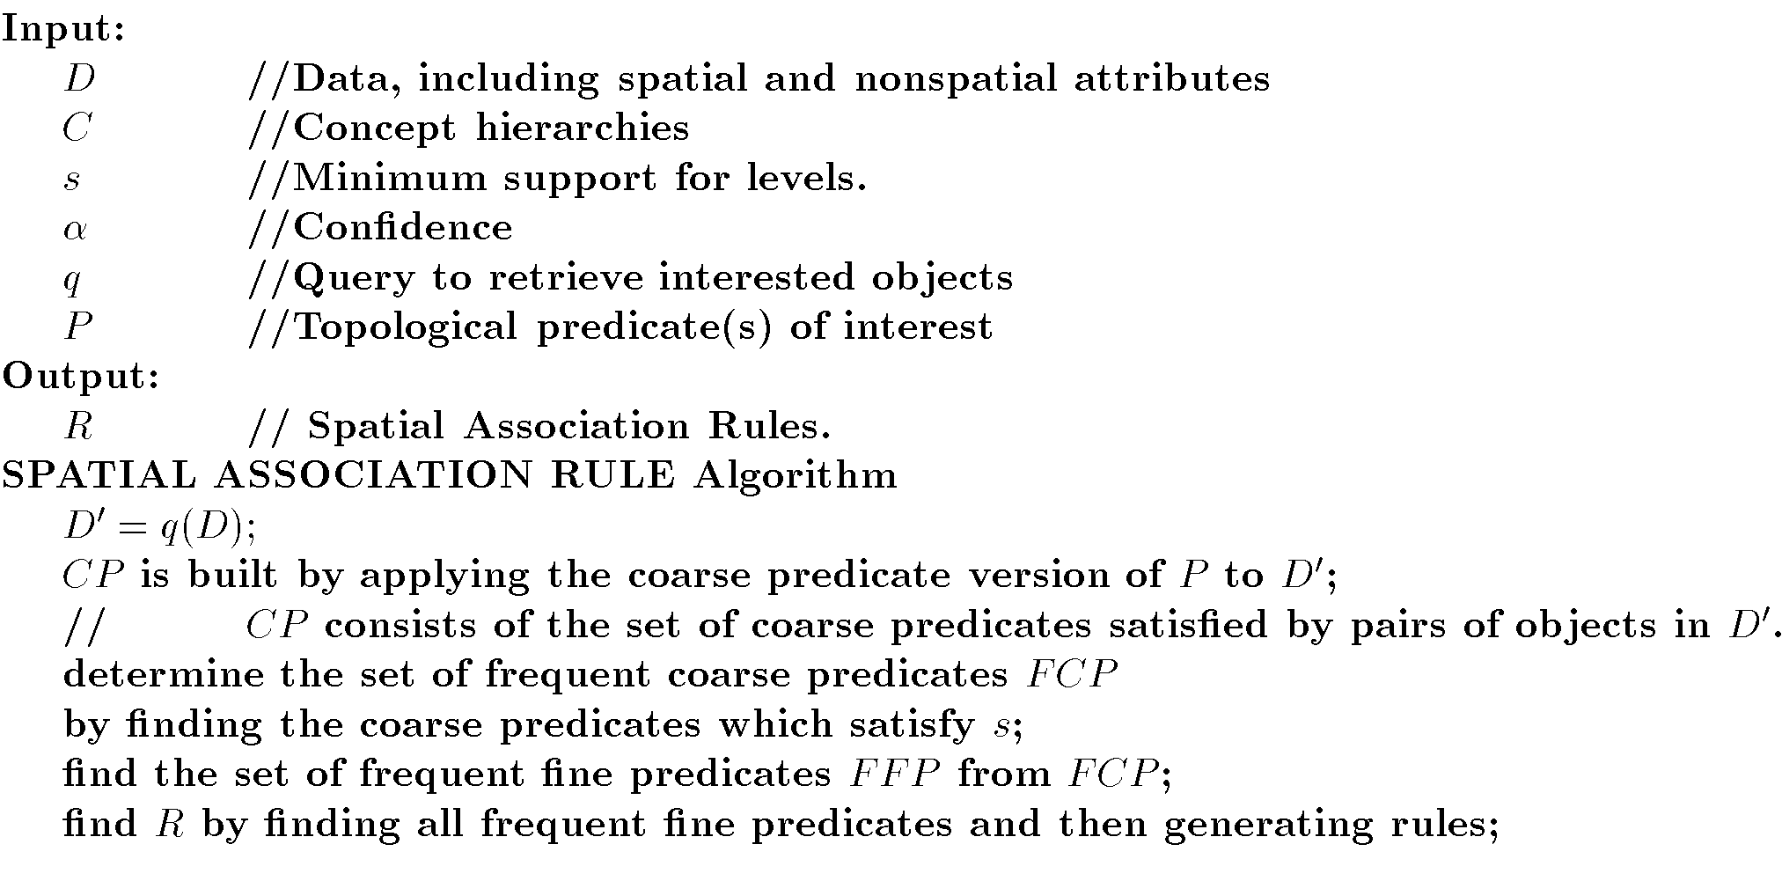
Spatial Association Rule Algorithm
© Prentice Hall

Slide 62
Spatial Classification
Partition spatial objects
May use nonspatial attributes and/or spatial attributes
Generalization and progressive refinement may be used.
© Prentice Hall

Slide 63
ID3 Extension
Neighborhood Graph
  Nodes – objects
  Edges – connects neighbors
Definition of neighborhood varies
ID3 considers nonspatial attributes of all objects in a neighborhood (not just one) for classification.
© Prentice Hall

Slide 64
Spatial Decision Tree
Approach similar to that used for spatial association rules.
Spatial objects can be described based on objects close to them – Buffer.
Description of class based on aggregation of nearby objects.
© Prentice Hall

Slide 65
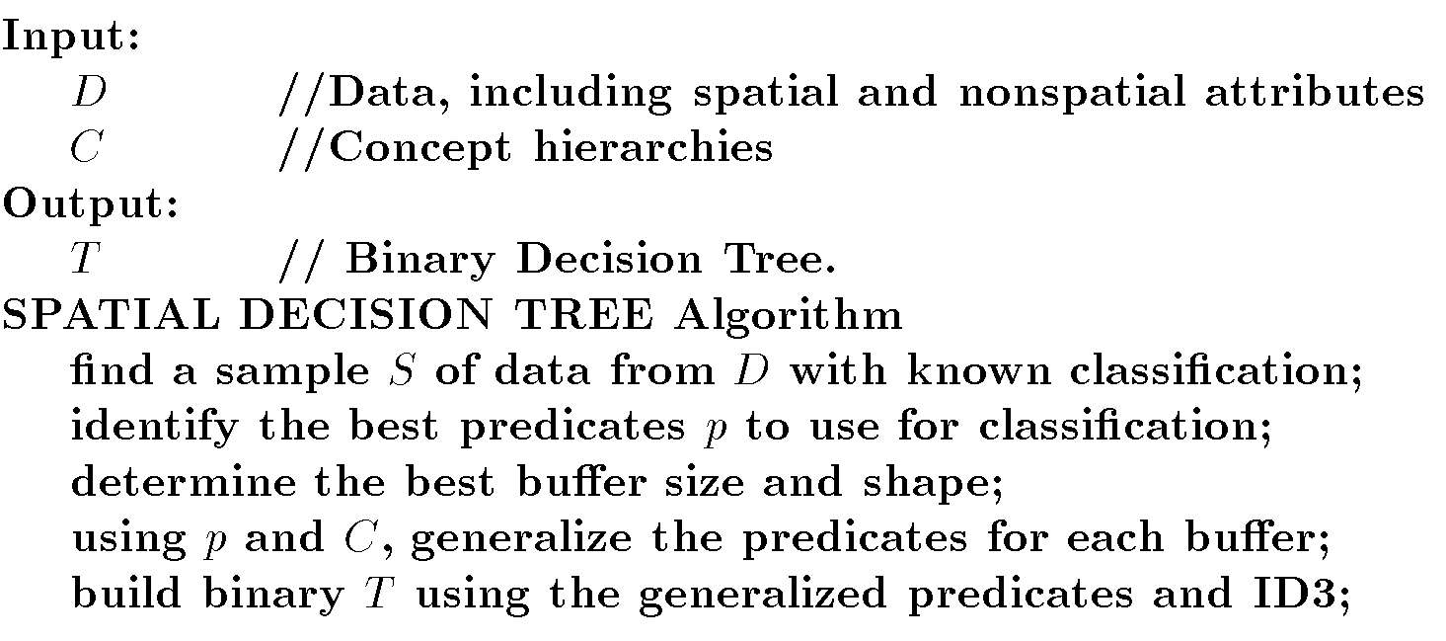
Spatial Decision Tree Algorithm
© Prentice Hall

Slide 66
Spatial Clustering
Detect clusters of irregular shapes
Use of centroids and simple distance approaches may not work well.
Clusters should be independent of order of input.
© Prentice Hall

Slide 67
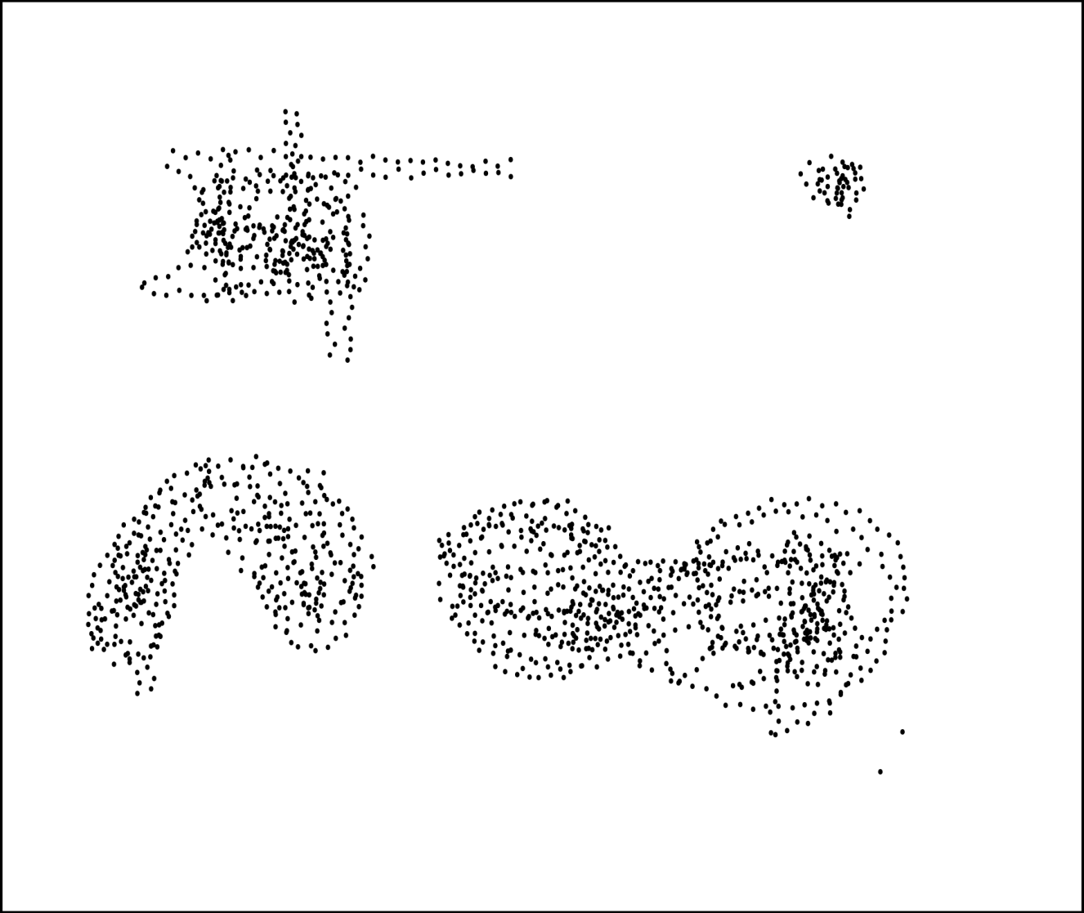
Spatial Clustering
© Prentice Hall

Slide 68
CLARANS Extensions
Remove main memory assumption of CLARANS.
Use spatial index techniques.
Use sampling and R*-tree to identify central objects.
Change cost calculations by reducing the number of objects examined.
Voronoi Diagram
© Prentice Hall

Slide 69
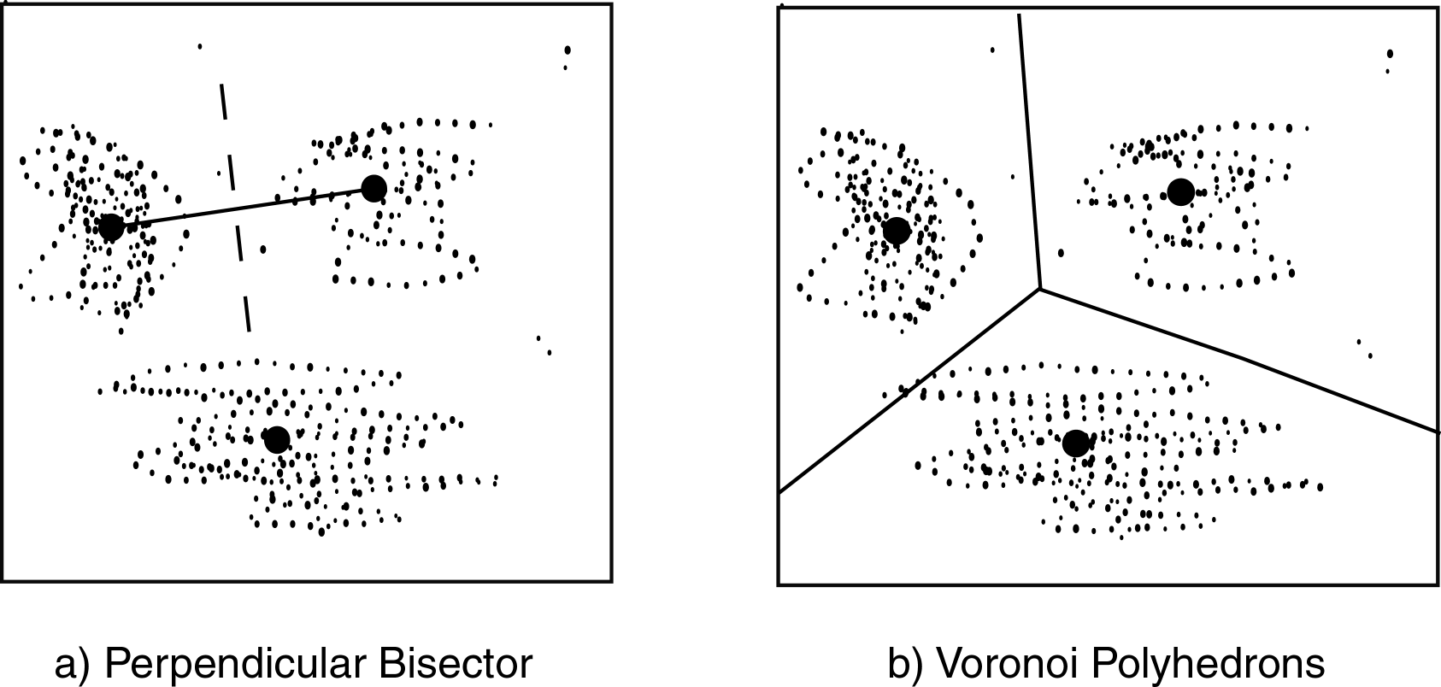
Voronoi
© Prentice Hall

Slide 70
SD(CLARANS)
Spatial Dominant
First clusters spatial components using CLARANS
Then iteratively replaces medoids, but limits number of pairs to be searched.
Uses generalization
Uses a learning to to derive description of cluster.
© Prentice Hall

Slide 71
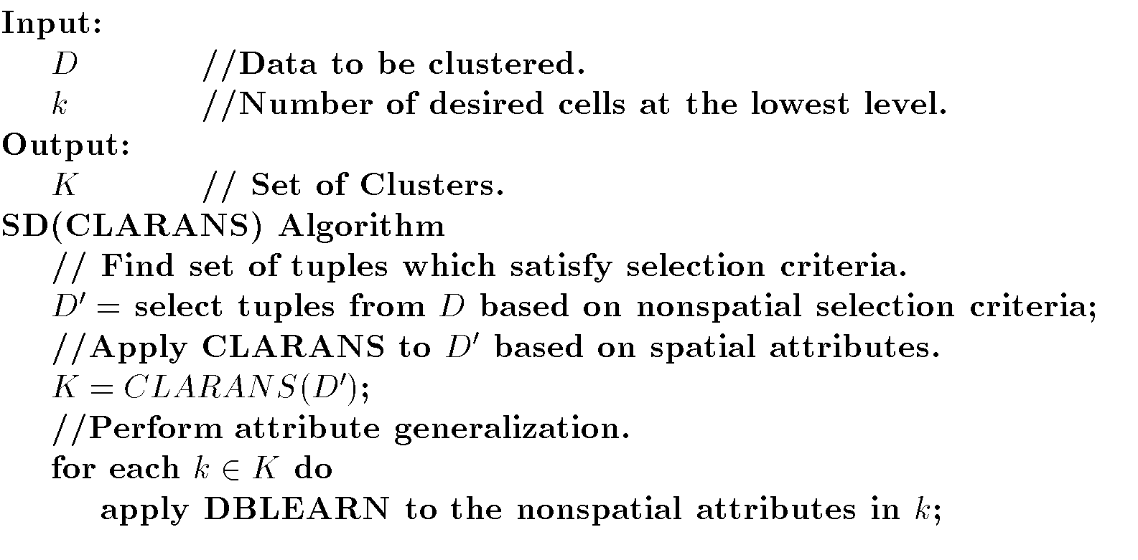
SD(CLARANS) Algorithm
© Prentice Hall

Slide 72
DBCLASD
Extension of DBSCAN
Distribution Based Clustering of LArge Spatial Databases
Assumes items in cluster are uniformly distributed.
Identifies distribution satisfied by distances between nearest neighbors.
Objects added if distribution is uniform.
© Prentice Hall

Slide 73
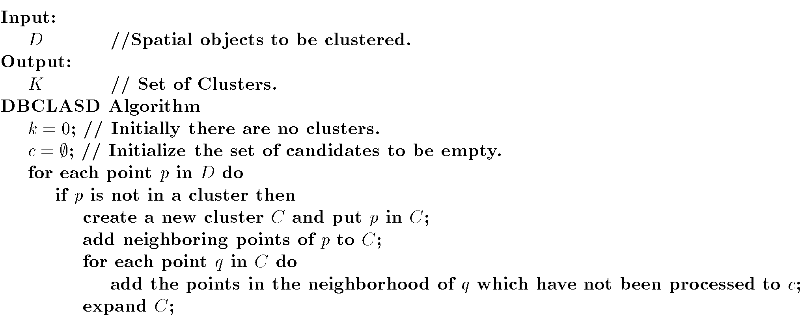
DBCLASD Algorithm
© Prentice Hall

Slide 74
Aggregate Proximity
Aggregate Proximity – measure of how close a cluster is to a feature.
Aggregate proximity relationship finds the k closest features to a cluster.
CRH Algorithm – uses different shapes:
  Encompassing Circle
  Isothetic Rectangle
  Convex Hull
© Prentice Hall

Slide 75
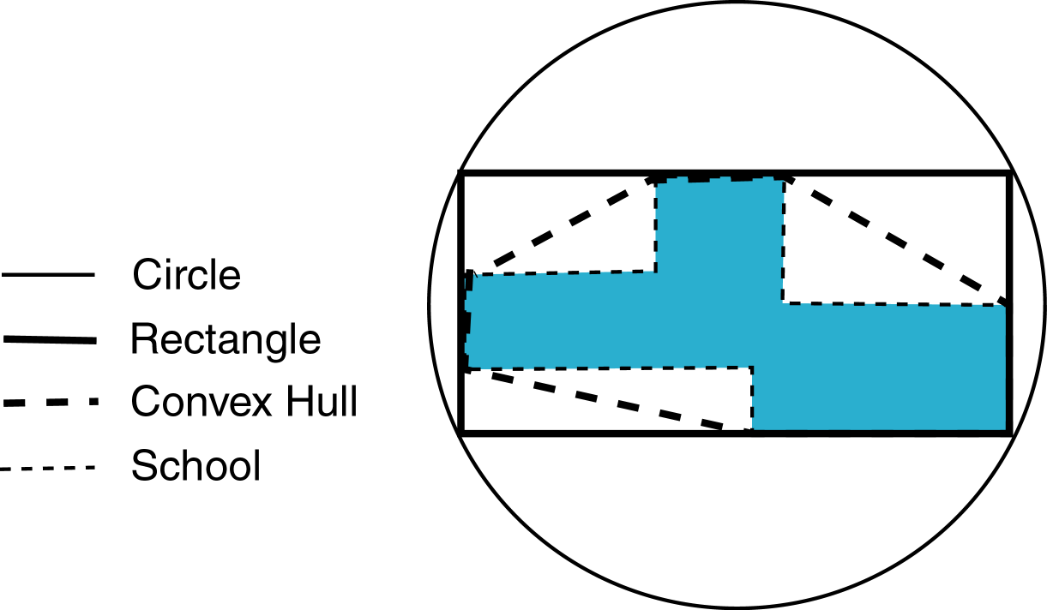
CRH
© Prentice Hall

Slide 76
Temporal Mining Outline
Goal: Examine some temporal data mining issues and approaches.
Introduction
Modeling Temporal Events
Time Series
Pattern Detection
Sequences
Temporal Association Rules
© Prentice Hall

Slide 77
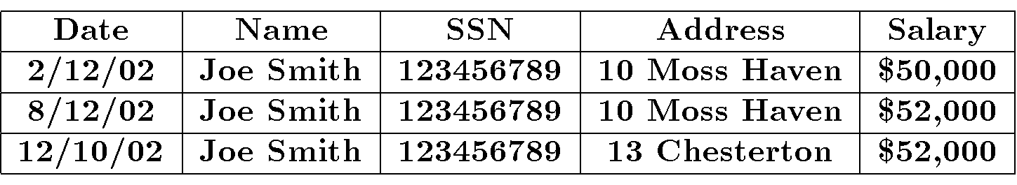
Temporal Database
Snapshot – Traditional database
Temporal – Multiple time points
Ex:
© Prentice Hall

Slide 78
Temporal Queries
Query
Database
Intersection Query
Inclusion Query
Containment Query
Point Query – Tuple retrieved is valid at a particular point in time.
t_{s}^{q} t_{e}^{q}
t_{s}^{d} t_{e}^{d}
t_{s}^{q} t_{e}^{q}
t_{s}^{d} t_{e}^{d}
t_{s}^{q} t_{e}^{q}
t_{s}^{d} t_{e}^{d}
t_{s}^{d} t_{e}^{d}
t_{s}^{q} t_{e}^{q}
© Prentice Hall

Slide 79
Types of Databases
Snapshot – No temporal support
Transaction Time – Supports time when transaction inserted data
  Timestamp
  Range
Valid Time – Supports time range when data values are valid
Bitemporal – Supports both transaction and valid time.
© Prentice Hall

Slide 80
Modeling Temporal Events
Techniques to model temporal events.
Often based on earlier approaches
Finite State Recognizer (Machine) (FSR)
  Each event recognizes one character
  Temporal ordering indicated by arcs
  May recognize a sequence
  Require precisely defined transitions between states
Approaches
  Markov Model
  Hidden Markov Model
  Recurrent Neural Network
© Prentice Hall

Slide 81
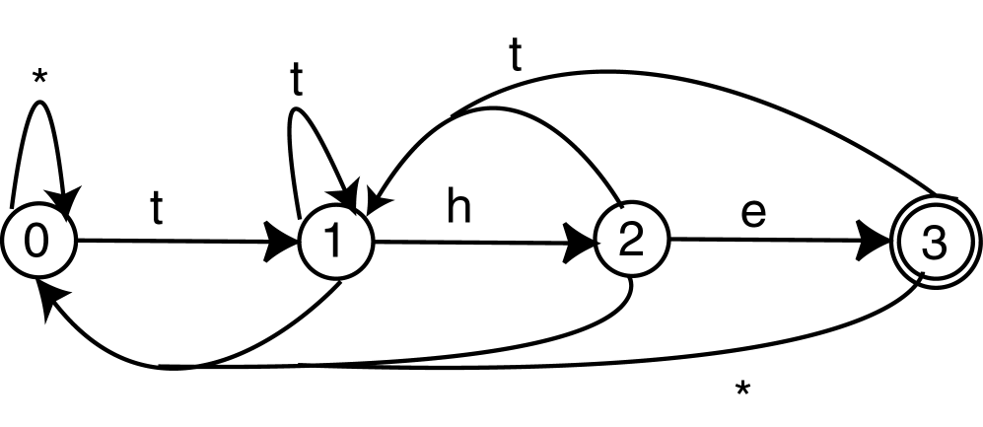
FSR
© Prentice Hall

Slide 82
Markov Model (MM)
Directed graph
  Vertices represent states
  Arcs show transitions between states
  Arc has probability of transition
  At any time one state is designated as current state.
Markov Property – Given a current state, the transition probability is independent of any previous states.
Applications: speech recognition, natural language processing
© Prentice Hall

Slide 83
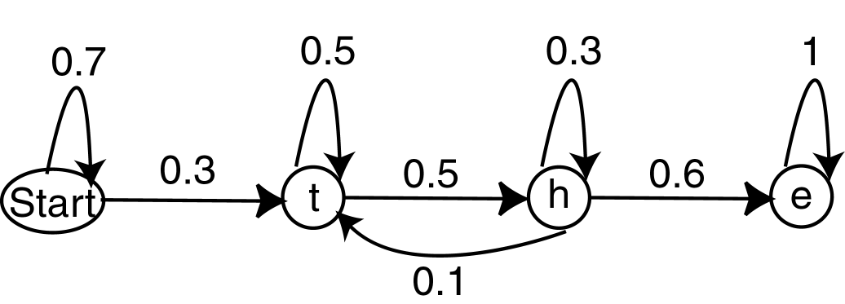
Markov Model
© Prentice Hall

Slide 84
Hidden Markov Model (HMM)
Like HMM, but states need not correspond to observable states.
HMM models process that produces as output a sequence of observable symbols.
HMM will actually output these symbols.
Associated with each node is the probability of the observation of an event.
Train HMM to recognize a sequence.
Transition and observation probabilities learned from training set.
© Prentice Hall

Slide 85
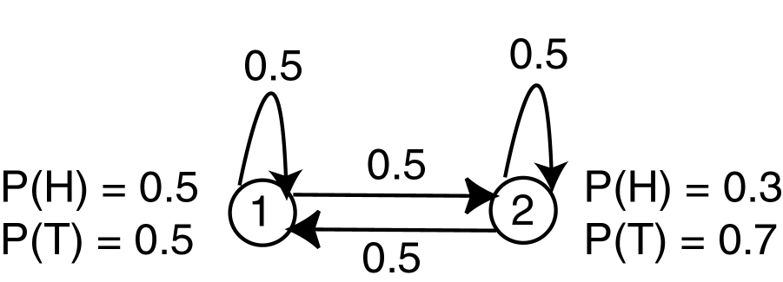
Hidden Markov Model
Modified from [RJ86]
© Prentice Hall

Slide 86
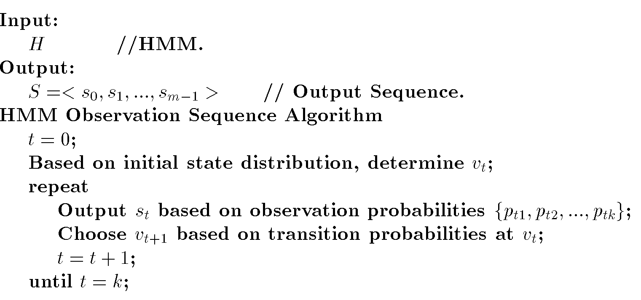
HMM Algorithm
© Prentice Hall

Slide 87
HMM Applications
Given a sequence of events and an HMM, what is the probability that the HMM produced the sequence?
Given a sequence and an HMM, what is the most likely state sequence which produced this sequence?
© Prentice Hall

Slide 88
Recurrent Neural Network (RNN)
Extension to basic NN
Neuron can obtian input form any other neuron (including output layer).
Can be used for both recognition and prediction applications.
Time to produce output unknown
Temporal aspect added by backlinks.
© Prentice Hall

Slide 89
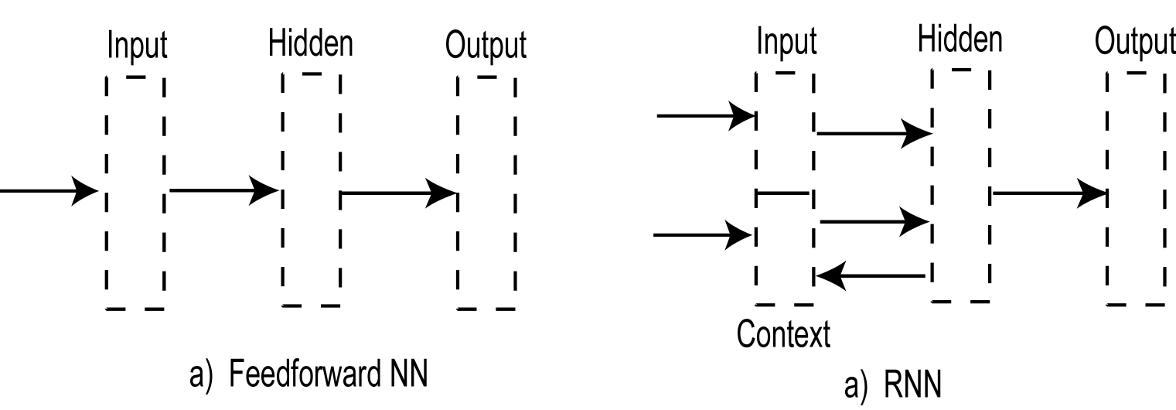
RNN
© Prentice Hall

Slide 90
Time Series
Set of attribute values over time
Time Series Analysis – finding patterns in the values.
  Trends
  Cycles
  Seasonal
  Outliers
© Prentice Hall

Slide 91
Analysis Techniques
Smoothing – Moving average of attribute values.
Autocorrelation – relationships between different subseries
  Yearly, seasonal
  Lag – Time difference between related items.
  Correlation Coefficient r
© Prentice Hall

Slide 92
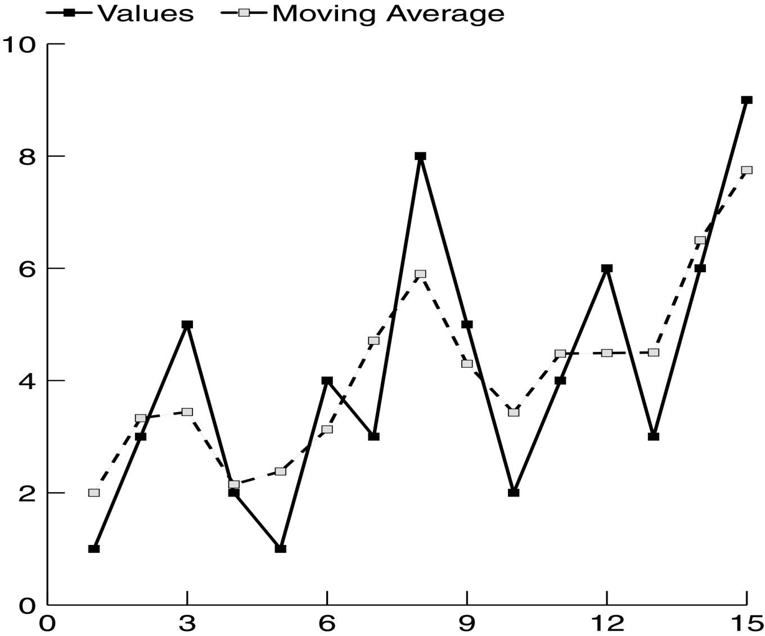
Smoothing
© Prentice Hall

Slide 93
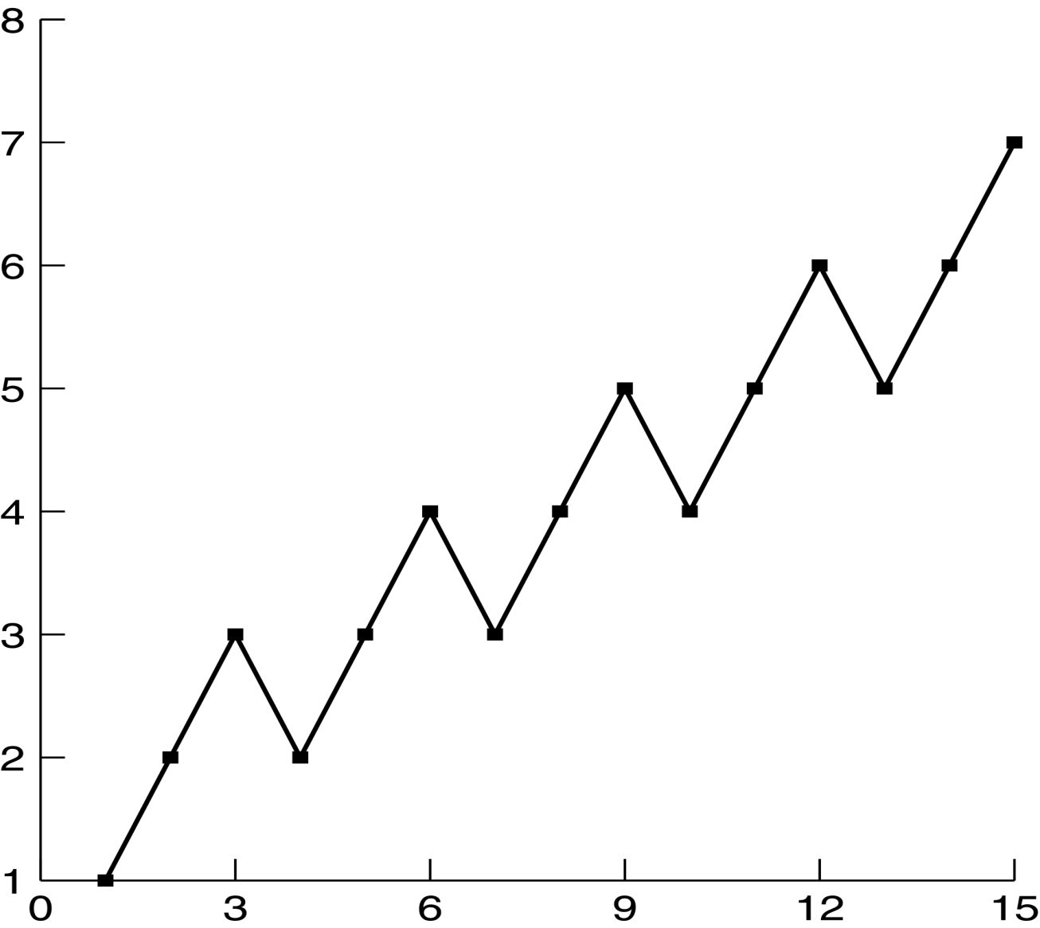
Correlation with Lag of 3
© Prentice Hall

Slide 94
Similarity
Determine similarity between a target pattern, X, and sequence, Y: sim(X,Y)
Similar to Web usage mining
Similar to earlier word processing and spelling corrector applications.
Issues:
  Length
  Scale
  Gaps
  Outliers
  Baseline
© Prentice Hall

Slide 95
Longest Common Subseries
Find longest subseries they have in common.
Ex:
  X = <10,5,6,9,22,15,4,2>
  Y = <6,9,10,5,6,22,15,4,2>
  Output: <22,15,4,2>
  Sim(X,Y) = l/n = 4/9
© Prentice Hall

Slide 96
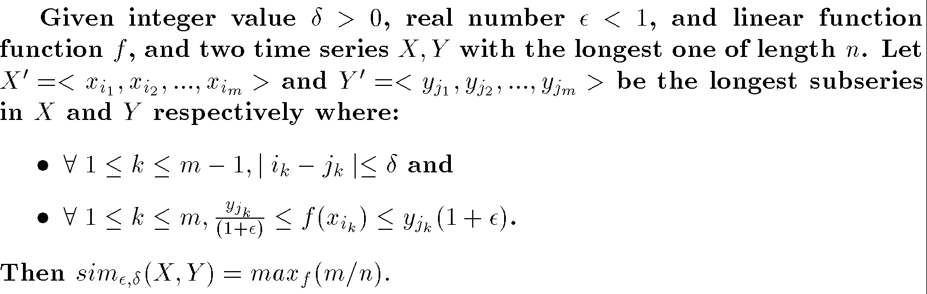
Similarity based on Linear Transformation
Linear transformation function f
  Convert a value form one series to a value in the second
ε_{f} – tolerated difference in results
δ – time value difference allowed
© Prentice Hall

Slide 97
Prediction
Predict future value for time series
Regression may not be sufficient
Statistical Techniques
  ARMA
  ARIMA
NN
© Prentice Hall

Slide 98
Pattern Detection
Identify patterns of behavior in time series
Speech recognition, signal processing
FSR, MM, HMM
© Prentice Hall

Slide 99
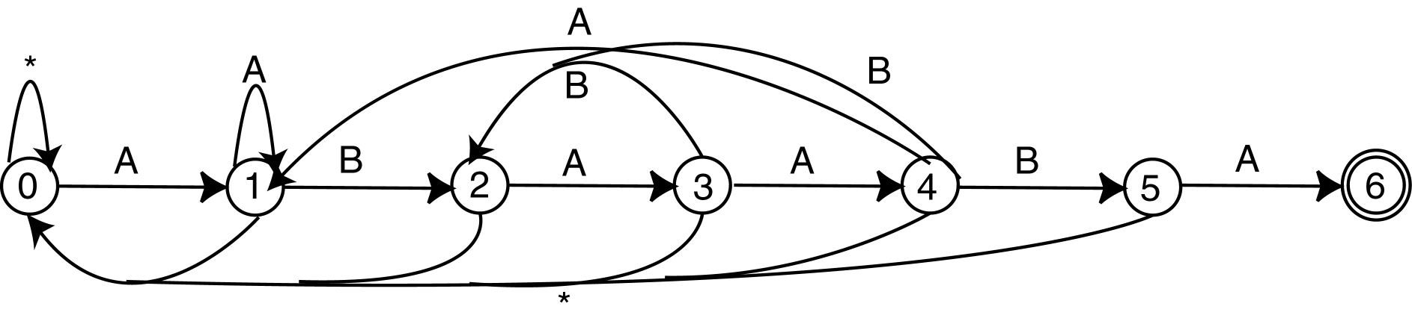
String Matching
Find given pattern in sequence
Knuth-Morris-Pratt: Construct FSM
Boyer-Moore: Construct FSM
© Prentice Hall

Slide 100
Distance between Strings
Cost to convert one to the other
Transformations
  Match: Current characters in both strings are the same
  Delete: Delete current character in input string
  Insert: Insert current character in target string into string
© Prentice Hall

Slide 101
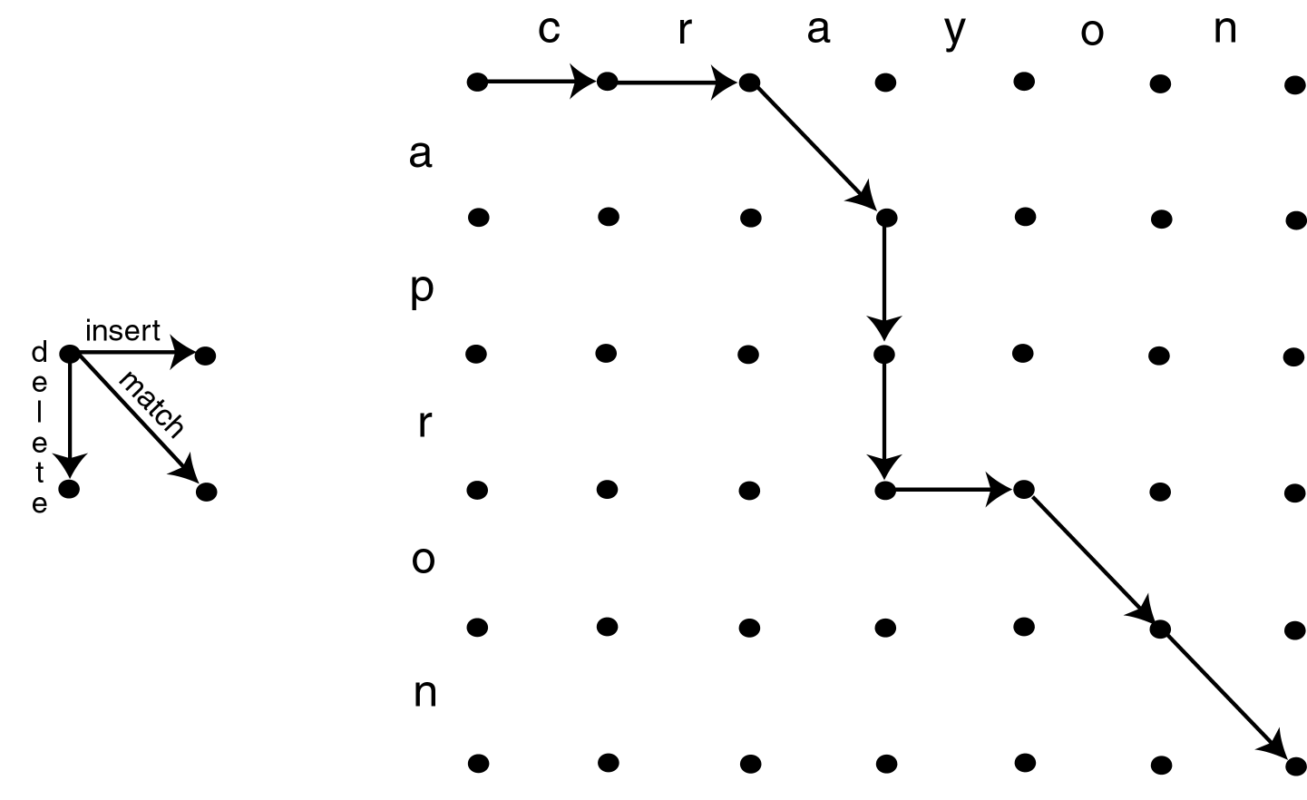
Distance between Strings
© Prentice Hall

Slide 102
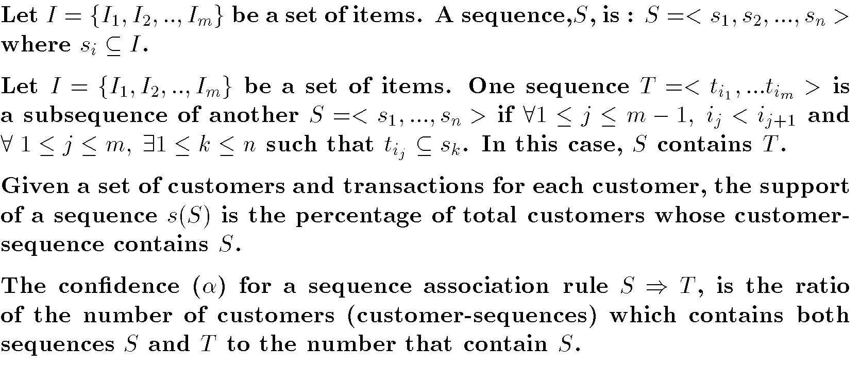
Frequent Sequence
© Prentice Hall

Slide 103
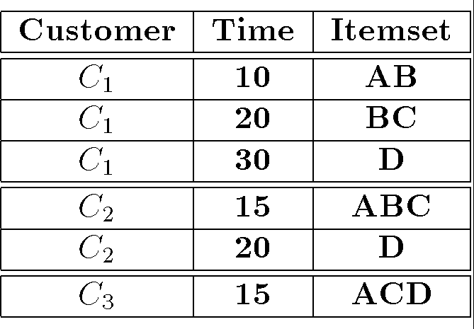
Frequent Sequence Example
Purchases made by customers
s(<{A},{C}>) = 1/3
s(<{A},{D}>) = 2/3
s(<{B,C},{D}>) = 2/3
© Prentice Hall

Slide 104
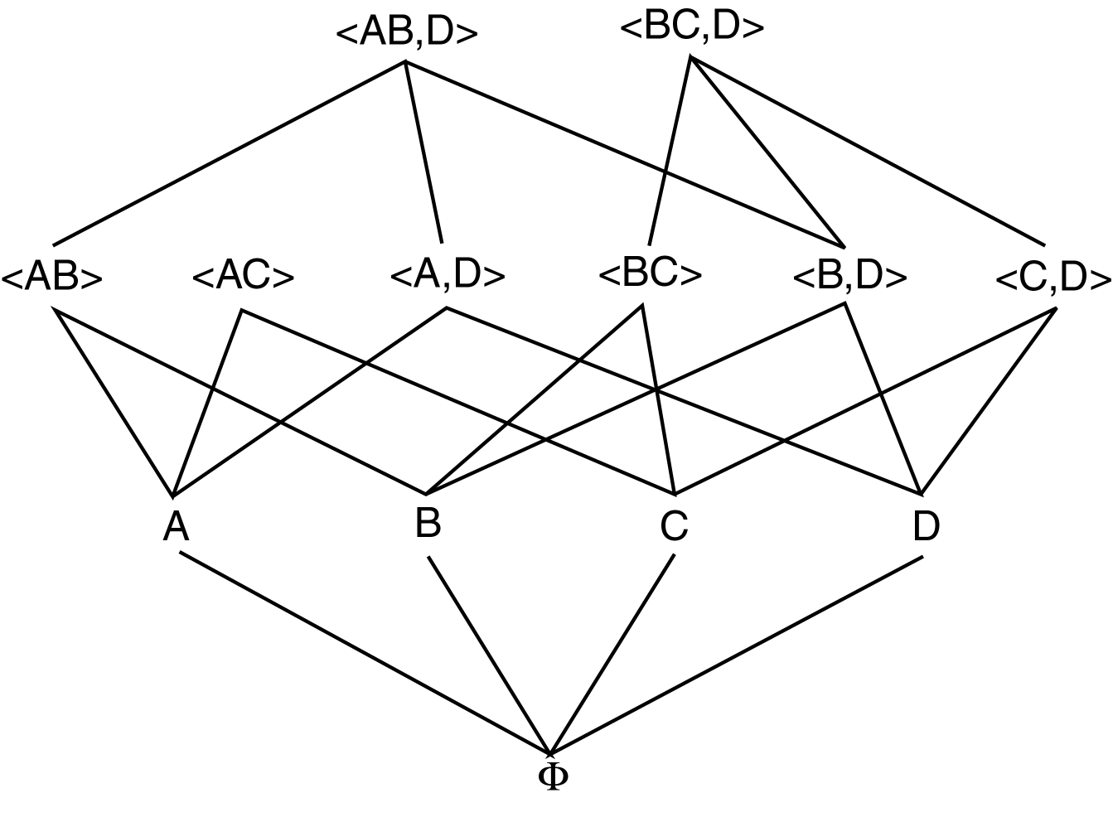
Frequent Sequence Lattice
© Prentice Hall

Slide 105
SPADE
Sequential Pattern Discovery using Equivalence classes
Identifies patterns by traversing lattice in a top down manner.
Divides lattice into equivalent classes and searches each separately.
ID-List: Associates customers and transactions with each item.
© Prentice Hall

Slide 106
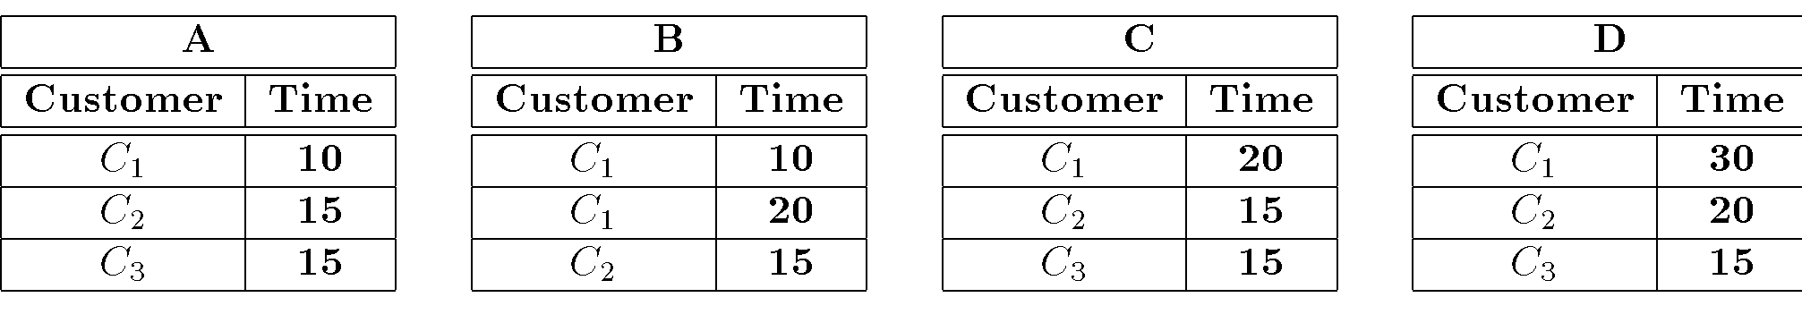
SPADE Example
ID-List for Sequences of length 1:
Count for <{A}> is 3
Count for <{A},{D}> is 2
© Prentice Hall

Slide 107
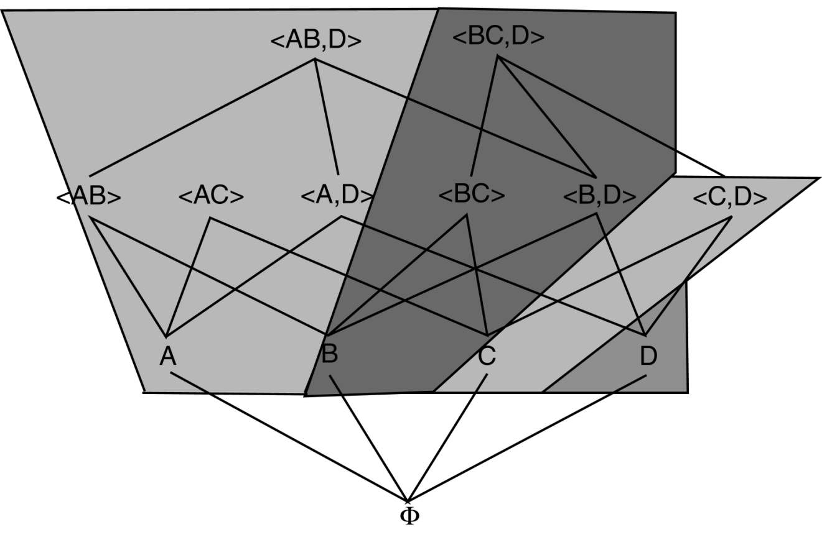
Θ₁ Equivalence Classes
© Prentice Hall

Slide 108
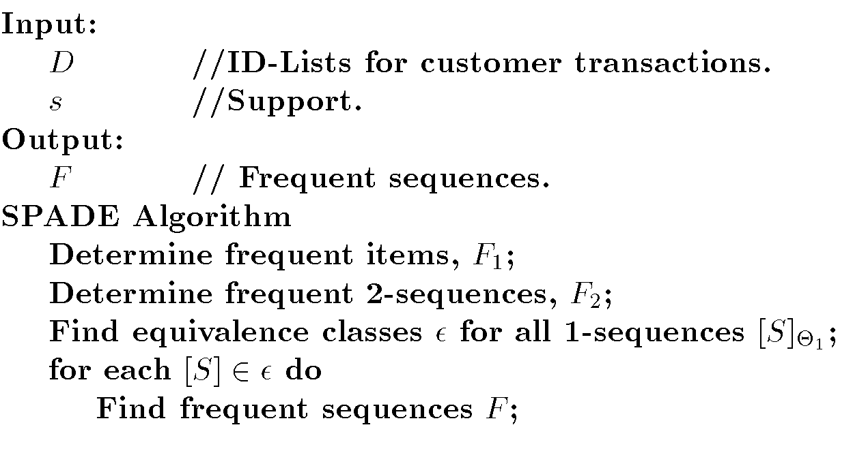
SPADE Algorithm
© Prentice Hall

Slide 109
Temporal Association Rules
Transaction has time:
  <TID,CID,I₁,I₂, …, I_{m},t_{s},t_{e}>
[t_{s},t_{e}] is range of time the transaction is active.
Types:
  Inter-transaction rules
  Episode rules
  Trend dependencies
  Sequence association rules
  Calendric association rules
© Prentice Hall

Slide 110
Inter-transaction Rules
Intra-transaction association rules
  Traditional association Rules
Inter-transaction association rules
  Rules across transactions
  Sliding window – How far apart (time or number of transactions) to look for related itemsets.
© Prentice Hall

Slide 111
Episode Rules
Association rules applied to sequences of events.
Episode – set of event predicates and partial ordering on them
© Prentice Hall

Slide 112
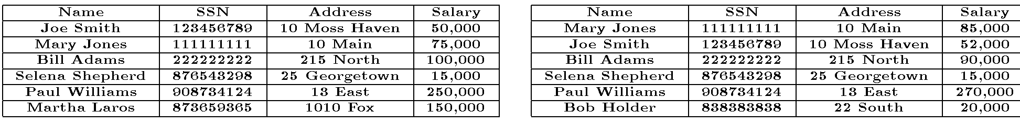
Trend Dependencies
Association rules across two database states based on time.
Ex: (SSN,=) ⇒ (Salary, ≤)
      Confidence=4/5
      Support=4/36
© Prentice Hall

Slide 113
Sequence Association Rules
Association rules involving sequences
Ex:
<{A},{C}> ⇒ <{A},{D}>
Support = 1/3
Confidence 1
© Prentice Hall

Slide 114
Calendric Association Rules
Each transaction has a unique timestamp.
Group transactions based on time interval within which they occur.
Identify large itemsets by looking at transactions only in this predefined interval.
© Prentice Hall

